Slide 1
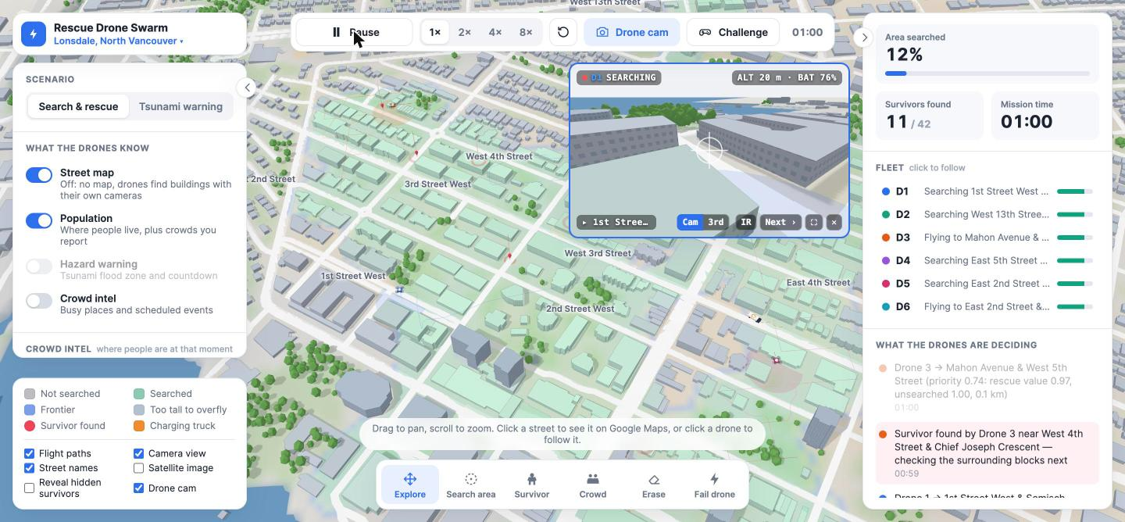
Rescue Drone Swarm
AUTONOMOUS SEARCH & RESCUE
AI-coordinated drone swarms, launched from rescue trucks, that find missing people faster when every second counts.
Live simulation
Real Vancouver streets
Notes:
Rescue Drone Swarm: autonomous drones that search a disaster area together and find people faster than a single helicopter or a ground team. What you see on the right is our live simulation over real North Vancouver streets: six drones, two charging trucks, and every block they have searched shaded green. One minute in, eleven survivors are already found.

Slide 2



Traditional search is slow, costly and risky
THE PROBLEM
Slow to start
Expensive
Dangerous
Helicopters and ground teams take hours to reach and cover a disaster zone.
Manned aircraft missions carry a huge cost for every hour in the air.
Rescuers are sent into unstable buildings, floods and smoke.
Notes:
In the first hours after a disaster, the people trapped have the best chance of survival. But helicopters and ground teams take time to get there, cost a lot for every hour, and put rescuers themselves in danger. We wanted to cover more ground, sooner, without sending people into harm's way.

Slide 3
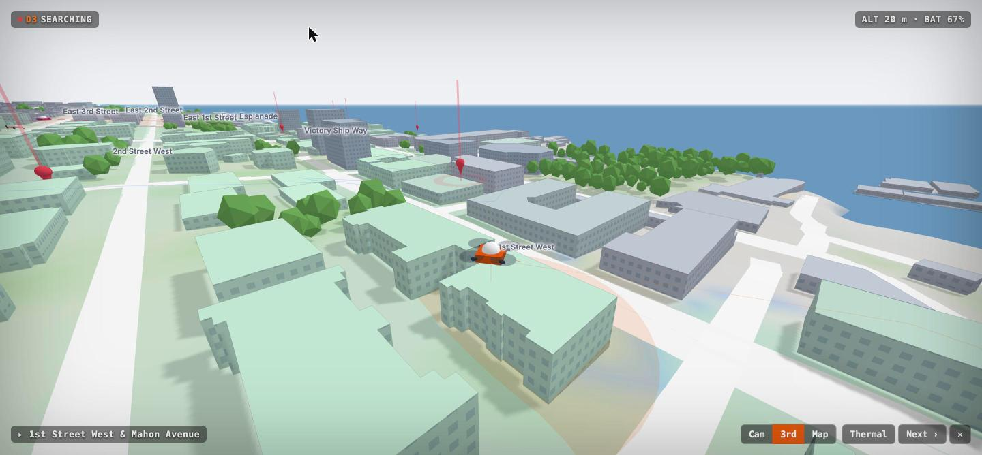

Launched from trucks, right at the edge of the disaster
MOBILE GROUND COMMAND
Trucks carry, charge and launch the drones, then drive to wherever the work is.
Draw a circle on the map and the swarm searches only inside it.
Below 20% battery a drone flies back to a truck, recharges and rejoins.
Notes:
Drones are carried and charged on rescue trucks parked at the perimeter. The operator just draws the area to search. Drones fly low between buildings at 20 metres, look at facades, avoid towers, and come back to the nearest truck to recharge on their own. The trucks themselves reposition toward where the drones are working.

Slide 4





One planner, one shared map, many drones
SWARM ARCHITECTURE
Observe
Share
Plan
Re-plan
Each drone's camera marks what it has seen, and finds buildings itself if there is no map.
Everything goes into one live map of searched and unsearched ground.
The central planner scores every block and auctions them to drones.
A find, a failed drone or a flood re-plans the whole fleet in seconds.
Notes:
The drones don't follow fixed routes. Every drone reports what its camera has seen into one shared map. A central planner, the swarm's message board, scores every 100-metre block by how likely people are there, hazards, distance and battery, and auctions the blocks to the drones. When something changes, a survivor found, a drone failing, a flood coming, it re-plans the whole fleet straight away, and explains every decision in the app's decision feed.

Slide 5
Satellite and census data tell the swarm where to look first
INFORMED STARTS
Open dataset | What it gives the drones
GHSL population (census-based) | Where people live, so dense blocks are searched first
Copernicus elevation | Which streets a tsunami or flood will reach
ESA WorldCover | Tree canopy, where thermal cameras see less
Sentinel-2 imagery | Open water and a real satellite view
OpenStreetMap | Real buildings, heights and streets for each area
Notes:
Instead of a blind grid search, the swarm starts informed. A Python pipeline processes open Earth-observation data: census-calibrated population to know where people are, an elevation model for flood zones, land cover to know where trees hide people from thermal cameras, and Sentinel-2 imagery for water and a satellite view. Buildings, their heights and every street come from OpenStreetMap.

Slide 6
Every second of flight finds as many people as possible
THE SEARCH ALGORITHM
Lanes sized to the camera
Value per second
No duplicate work
Blocks are ranked by people per unit of search time, so nearby half-done blocks get finished.
Edges the next block's sweep will cover are left to it, not searched twice.
Each block is swept in back-and-forth lanes spaced to what the camera sees clearly.
Notes:
We measured where the drones' time went and fixed the waste. Blocks are swept in lawnmower lanes spaced to the camera's clear range. The planner ranks blocks by value per second of searching, which stopped the old checkerboard pattern of half-searched blocks the fleet had to fly back to. And the clean-up step no longer chases edge cells that the neighbouring block's sweep covers anyway; those were 72 percent of clean-up targets.

Slide 7
People found sooner, with less flying
MEASURED IN THE SIMULATION
24%
14%
0
more survivors found in the first 5 minutes with the population map (16.0 → 19.8 of 25)
shorter full missions after the search redesign (569 → 487 s)
flights through buildings, with or without a street map
20 simulated missions over real Metro Vancouver areas (Lonsdale, Metrotown), 6 drones, 25 survivors each.
Notes:
All of these come from repeatable benchmarks in our simulator, not estimates. Turning on the census-based population map, drones find 19.8 of 25 survivors within five minutes instead of 16. The search redesign cut full-mission time from 569 to 487 seconds with the same number of survivors found. And our regression test checks every drone position against the real building footprints of downtown Vancouver: zero flights through buildings, even when drones have no map and must discover buildings with their cameras.

Slide 8

When a wave is coming, the flood zone goes first
DYNAMIC ADAPTATION
Real-time re-planning
Urgency rises as impact nears, and drones are reassigned on the fly with no operator input.
In the tsunami scenario the swarm knows which streets will flood and how long is left. It searches those first and rescues people before the water arrives.
Same planner: wildfire edges or a flash flood next
Notes:
The same planner adapts to any hazard. In our tsunami warning scenario, the elevation model tells the swarm which low-lying streets will flood. Their priority rises as the wave gets closer, the fleet is reassigned automatically, and anyone not found before impact is lost, so the metrics show how many lives the strategy actually saves. The example from our idea, a missing hiker in a forest with a flash flood coming, works the same way.

Slide 9
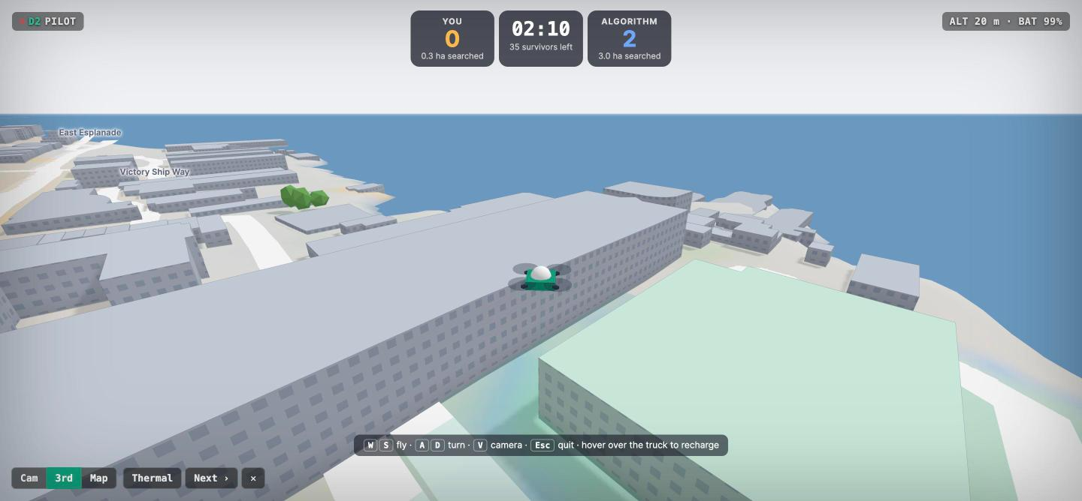
Fly against the algorithm
CHALLENGE MODE
One drone is yours (WASD), one is the algorithm's: same truck, speed, camera and battery. Most survivors in 2:30 wins.
Every game is stored in Snowflake, building a public record of human against algorithm.
Notes:
To prove the algorithm works, we let people race it. You fly one drone with the keyboard, the algorithm flies an identical one from the same truck, and you both search for the same hidden survivors for two and a half minutes. Every result goes into Snowflake, so the History panel shows the running record of human against algorithm. Want to try? It's live on our site.

Slide 10


One swarm brain for every kind of disaster
WHAT COMES NEXT
Wildfire tracking
Floods and storms
Real drones
Many drones watch fire edges and smoke from many angles at once, far richer than one helicopter.
Live satellite passes update the flood map while the swarm is in the air.
The same planner, driving real hardware through a standard flight-control link.
Notes:
The planner is hazard-agnostic: hazards are just layers on the map. Next we want to add wildfire spread and smoke, refresh flood maps from new satellite passes during a mission, and connect the same planner to real drones through a standard flight-control interface.

Slide 11

Saving lives through autonomous intelligence
RESCUE DRONE SWARM
From slow, expensive manned missions to coordinated drone swarms that adapt to any disaster.
Try it live: rescue-drone-swarm.vercel.app
Scan to try it
github.com/PutridThunder/Rescue_Drone_Swarm
For the best experience, use a laptop
Notes:
Thank you. Rescue Drone Swarm turns slow, expensive and risky manned searches into coordinated drone swarms that find people faster. Scan the code or go to rescue-drone-swarm.vercel.app to try it live, ideally on a laptop, race the algorithm, and tell us if you can beat it.

